Slide 1

Financial Education and Financial Literacy: Emerging Insights
Ruchika Singh,
Senior Policy Manager and Finance Sector Lead,
J-PAL South Asia
9 November, 2017
Notes:
Add relevant title

Slide 2





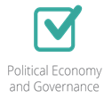









J-PAL’s mission is to reduce poverty by ensuring that policy is informed by scientific evidence.
What we do
J-PAL conducts randomized evaluations to test and improve the effectiveness of poverty reduction programmes across sectors.
Agriculture
Crime
Education
Environment and Energy
Health
Finance and Microfinance
Labour
Markets
Political Economy & Governance
Who we are
Where we work
Network of 154 professors from over 49 universities…
Headquartered at MIT, 7 regional offices and research in 80 countries

Slide 3
J-PAL’s finance sector
Measure the impact of financial services, products, and process innovations
Understand how access to financial services can be used as a mechanism to reduce poverty and spur economic development
861 evaluations,
8 sectors, 80 countries
Finance sector, 248 evaluations, 53 countries
Financial products
Financial Inclusion
Social protection
Microcredit
Remittances
Savings
Insurance
Financial education & literacy
Mobile money
Islamic finance
Universal basic income
Graduation programmes

Slide 4
Why do we care about financial education & literacy?
Question to policymakers: What is most effective policy to improve financial access for the poor?
Low financial literacy is a major barrier to financial inclusion
76% of Indians are not financially literate (do not understand concepts of risk diversification, interest and inflation)
Policymakers link financial literacy and capability to financial education
Theory of Change
Lack of understanding or use financial products incorrectly
People participate in lessons
Effective financial education delivered
Financial education lessons applied in practice
Better financial health and growth
World Bank, 2014 (poll), The Standard & Poor’s Ratings Services Global Financial Literacy Survey 2014

Slide 5
Challenges of financial education programmes
Lack of understanding or use financial products incorrectly
People participate in lessons
Effective financial education delivered
Financial education lessons applied in practice
Better financial health and growth
1
2
Low take-up is often an issue, even with incentives
Limited evidence of knowledge translating to action
  Meta-analysis of studies find limited downstream impacts of financial education
Challenge of isolating impact of training on outcomes
  Randomized evaluations allow us to measure true impact of financial education
Based on studies in Mexico, Qatar, and Dominican Republic
Based on studies in Dominican Republic, India, Indonesia, and Philippines
Miller et al., 2014 (overview)

Slide 6
Addressing low take-up
Lack of understanding or use financial products incorrectly
People participate in lessons
Effective financial education delivered
Financial education lessons applied in practice
Better financial health and growth
Country | Training | Incentive | Attendance rate | Target Population
Mexico | 4-hour session | Free transport | 25% | All adults in Mexico City, recruited online, via mail, and in-person surveys on busy streets and in line at the partner financial institution
 |  | $72 gift card | 39%
Qatar | 3-hour session | Dinner | 41% | Indian migrant workers and their wives
Dominican Republic | 5-6 weekly 3-hour sessions | (none) | 44% | Existing creditors of the partner financial institution
Benefits of financial education can be perceived as low
Policymakers need to think about take-up of lessons, incentives and targeting and communicating the benefits of financial education
Bruhn et al., 2013 (Mexico); Seshan and Yang, 2012 (Qatar); Drexler et al., 2010 (Dominican Republic)

Slide 7
Designing effective financial education
Lack of understanding or use financial products incorrectly
People participate in lessons
Effective financial education delivered
Financial education lessons applied in practice
Better financial health and growth
  Dominican Republic: Entrepreneurs who received simple rules of thumb (Financial Heuristics) training vs a standard accounting training were more likely to improve business practices and performance
Details:
Savings and credit bank clients with small businesses were offered two types of financial training programs with different approaches:
  6 week standard accounting training or 5 weeks rules of thumb training
Results:
Clients receiving rule-of-thumb training:
  More likely to separate their accounts, calculate revenue formally, and keep account records
  Improved business outcomes, and average sales increased, especially during bad weeks
Reduce complexity of trainings like sharing simple, easy to recall yet sound business practices
Drexler et al., 2010

Slide 8
Designing effective financial education
Lack of understanding or use financial products incorrectly
People participate in lessons
Effective financial education delivered
Financial education lessons applied in practice
Better financial health and growth
  India and Philippines: Using mobile phones as a delivery channel for scaling up of rules of thumb based training
Details:
For testing a cheap and scalable ‘rules of thumb’ based training approach:
  Develop and test the effectiveness of a mobile-phone based technology (weekly voice-based messages with follow-up reminder messages)to provide rules of thumb training to micro entrepreneurs in India (Completed)
    Results: Mobile phone an effective delivery channel for rules of thumb based training
  Adapt content from India for Philippines and design scale-up version for both India and Philippines (Ongoing)
    Results: Expected in December 2017
Policymakers need to think about feasibility of scaling up effective programmes
Cole and Schoar (ongoing)

Slide 9
Designing effective financial education
Lack of understanding or use financial products incorrectly
People participate in lessons
Effective financial education delivered
Financial education lessons applied in practice
Better financial health and growth
Indonesia: Targeted, actionable & accessible training for overseas migrant workers increases financial knowledge
Details:
Indonesian overseas migrant workers and their families trained on financial planning, sending/receiving remittances and understanding migrant insurance
Measured the relative efficacy of delivering training only to migrant worker, only to main remittance receiver, or both
Results:
When the worker alone or the remittance receiver were trained, financial knowledge increased; but knowledge increase was greatest when both were trained together
Greater financial planning, budgeting, and saving when both the worker and the family member were trained
Policymakers need to think about making trainings timely, targeted, actionable and accessible
Doi et.al (Indonesia)

Slide 10
Designing effective financial education
Lack of understanding or use financial products incorrectly
People participate in lessons
Effective financial education delivered
Financial education lessons applied in practice
Better financial health and growth
India: Personalized add-ons to a financial education course positively affect financial behaviors
Details:
Five weeks of financial literacy training consisting of a five-week video series covering budgeting, savings, loans, and insurance along with personalized add-ons like financial counseling and goal-setting
Results:
Financial education videos alone increased awareness of financial products, but not behaviors
Bundling training with personalized add-ons, like goal-setting and counseling leads to impact on both financial knowledge and behaviors
People face multiple constraints in improving financial behaviour
Simple strategies to overcome behavioural barriers such as procrastination and forgetfulness can result in increased impact
Policymakers need to think about making trainings personalised and actionable
Carpena et al., 2010 (India)

Slide 11
Conclusion
Initial low take-up is often an issue, with limited subsequent impact on financial behaviours
Difficult to translate knowledge to action
Trainings that are simple, targeted, actionable, and/or accessible are more likely to be effective
Practitioners, policymakers and researchers need to work together to better understand how to improve take-up and design, test and pilot effective programmes
Open questions
What strategies can be used to ensure that improvements in knowledge are applied to real-world financial decisions?
Which financial education strategies are most cost-effective? How do you compare cost-effectiveness of different financial education and literacy programs?
How do you deal with the challenges of scaling up effective programs? Are digital solutions are the way to go?

Slide 12
Thank you
Ruchika Singh
rsingh@povertyactionlab.org

Slide 13


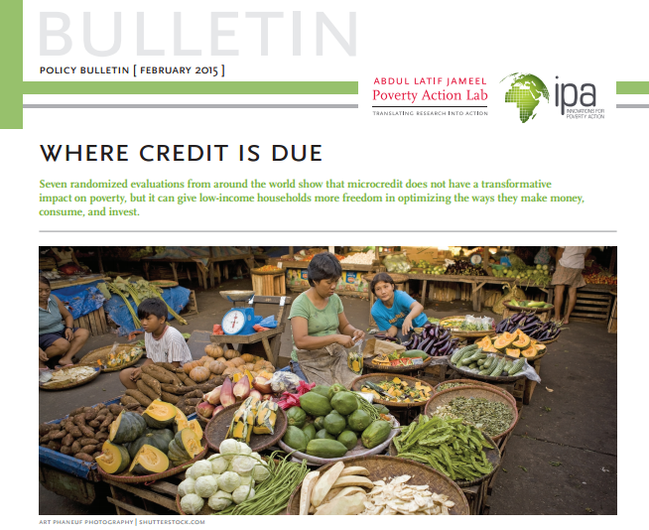
Learn more
www.povertyactionlab.org/finance
www.poverty-action.org/program-area/financial-inclusion

